Slide 1
Open Access Publishing
Benjamin Derksen bder@kb.dk Information Specialist at the Faculty Library for Social Sciences and Research Services Copenhagen University Library

Slide 2
Agenda
1.0) The traditional publishing model
2.0) The Open Access (OA) intervention (What is OA?)
2.1) The OA taxonomy, and how each path works
2.2) Useful OA tools in the publishing process
2.3) OA in research policy
2.4) Article Processing Charges and the Royal Library’s agreements
3.0) A brief word on copyright
4.0) A brief review
4.1) Questions and discussion

Slide 3
1.0 Traditional Academic Publishing
Idea!
Manuscript
Peer Review
Revisions
Version of Record

Slide 4
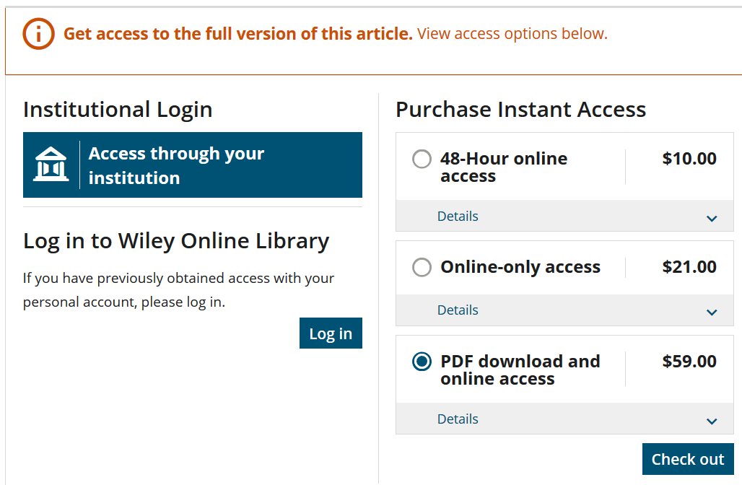
The final product and paywalls

Slide 5
Who owns the copyright?
Notes:
In traditional publishing, you sign away the copyright to the publisher, in this case Elsevier.

Slide 6
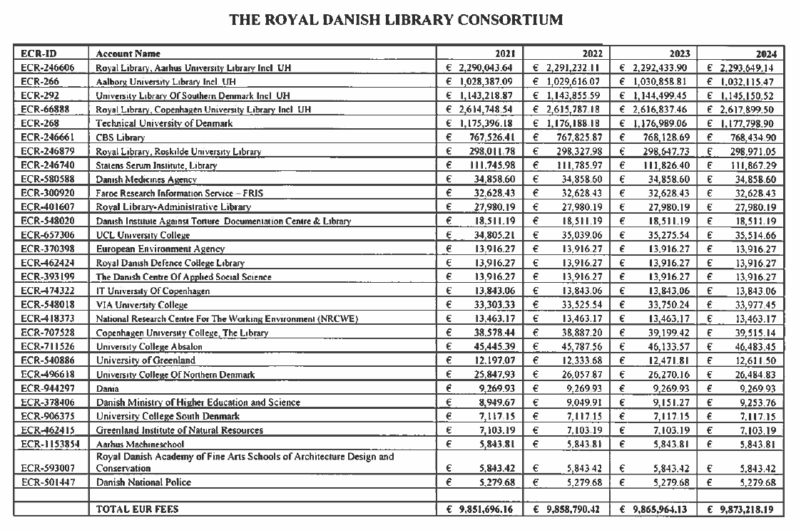
A mark, a yen, a buck or a pound…
…is all that makes the world go around

Slide 7

2.0 Open Access (OA) : What is it?

Slide 8
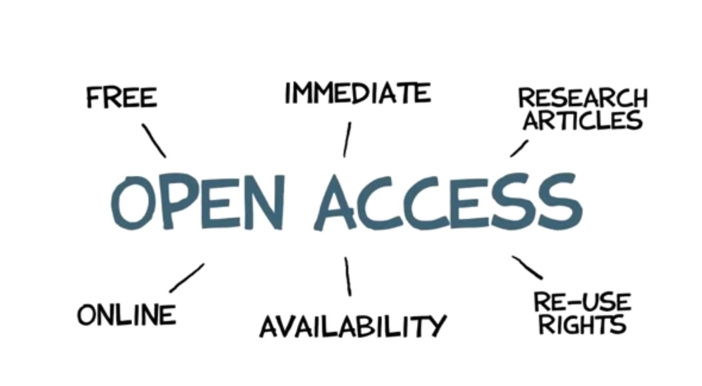
What is Open Access?
Source: https://upload.wikimedia.org/wikipedia/commons/transcoded/7/71/PhD_Comics_Open_Access_Week_2012.ogv/PhD_Comics_Open_Access_Week_2012.ogv.480p.vp9.webm

Slide 9
Benefits of Open Access
Unhindered access
Societal benefits
Increased collaboration
More transparency
Greater impact (downloads, citations, etc.)

Slide 10
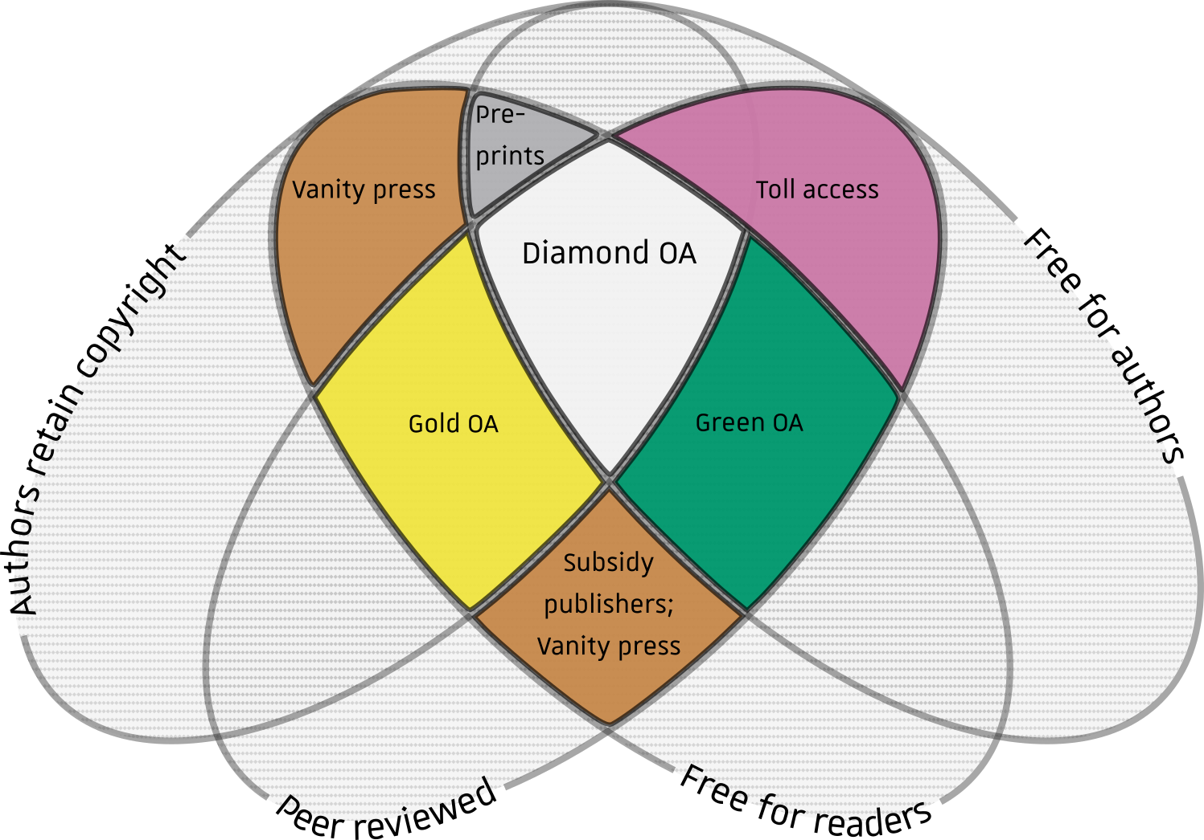
2.1 The Open Access Typology
Source: Adapted from, Jamie Farquharson, ”Introducing Volcanica: The first diamond open-access journal for volcanology” Volcanica 1 (1): i-ix. DOI:10.30909/vol.01.01.i-ix ISSN 2610-3540

Slide 11
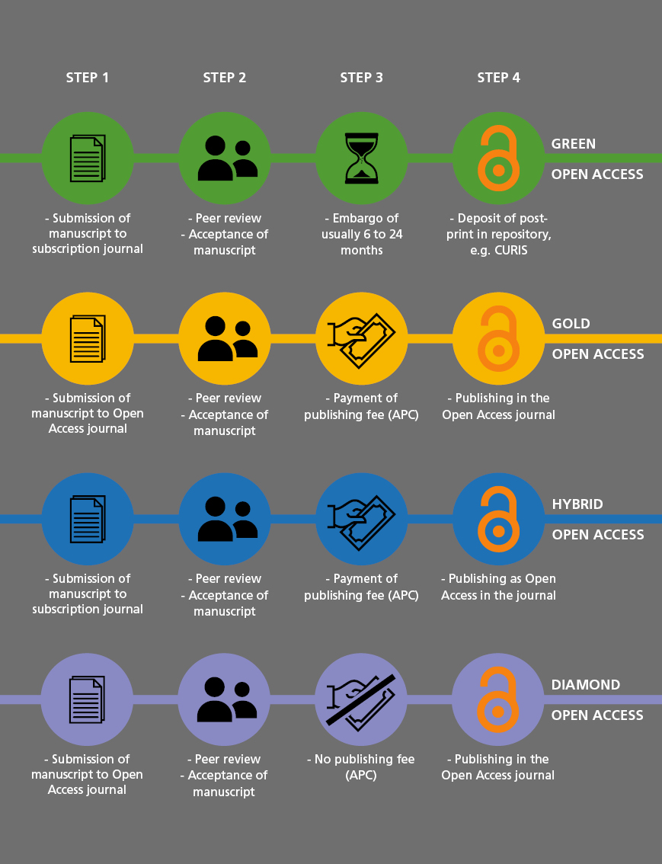
Open Access Types

Slide 12
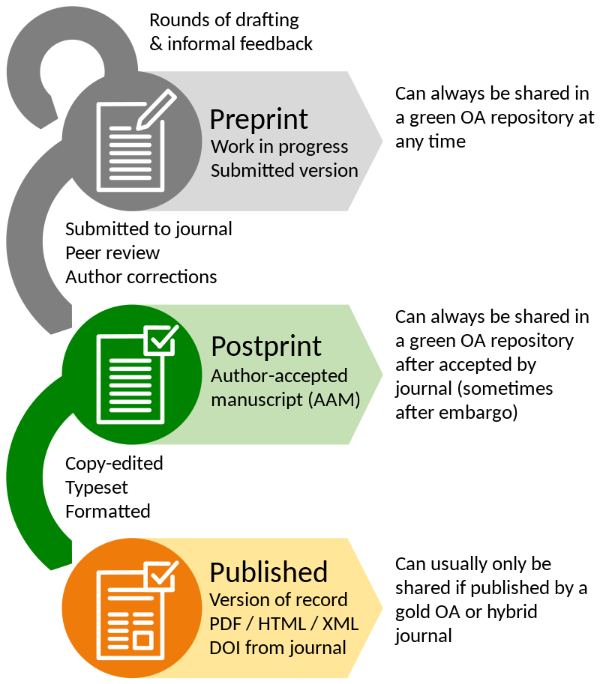
Manuscript versions & Open Access publishing
Green Open Access: The postprint = The accepted manuscript
Self-archiving in an institutional repository
Embargo period: 0-24 months
Free of charge
Gold or Hybrid Open Access: The published article
Access at the website of the publishers
The articles are immediate Open Access
Article Processing Charge (APC)
Notes:
Green Open Access actually means self-archiving: you can publish in the journal of your choice, and deposit the post-print in a repository and make it publically available, sometimes after an embargo period set by the publisher, which can last up to 24 months. Green OA is free of charge.
Since Green Open Access is an easy way of making your research OA, we urge you to get hold of the postprint from either the corresponding author or the publisher to upload it in CURIS. Since the publisher does not keep the postprint for long after publication, do not hesitate to request it. If you get hold of the postprint, you are most welcome to send it to the library and we are going to upload it for you.
In Gold and Hybrid Open Access you pay an Article Processing Charge to provide immediate Open Access to the articles published. As mentioned publishing is big business and for that reason the APC can be huge. In the case of Elsevier journals, the APC ranges from 150 USD to 9900 USD depending on the journal.

Slide 13
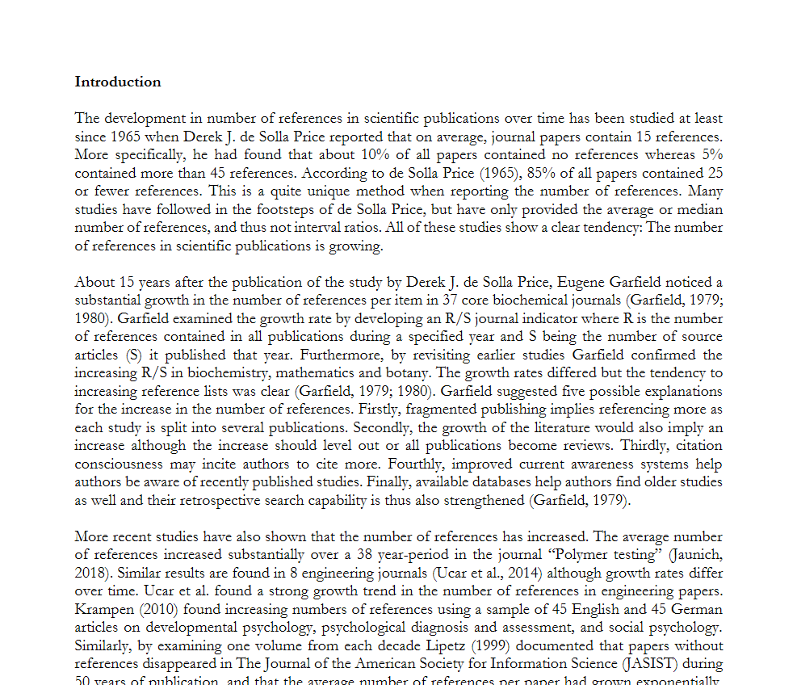
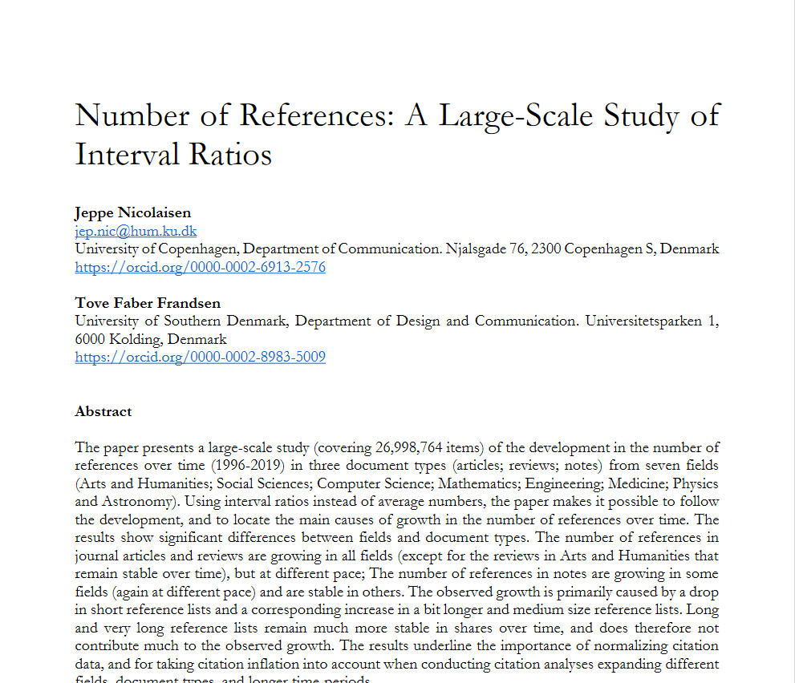
Postprint

Slide 14
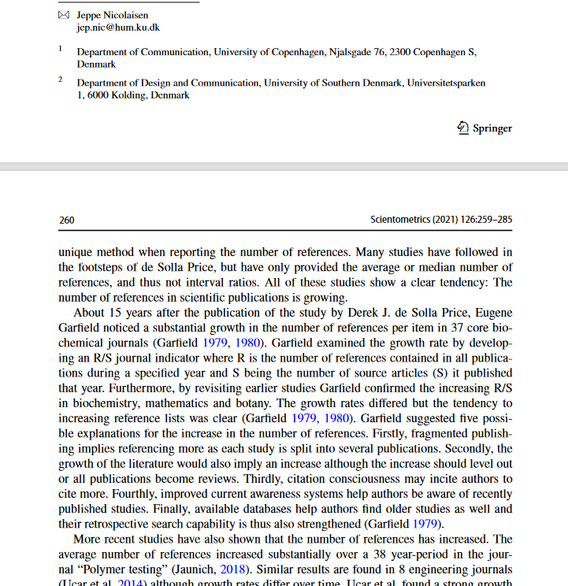
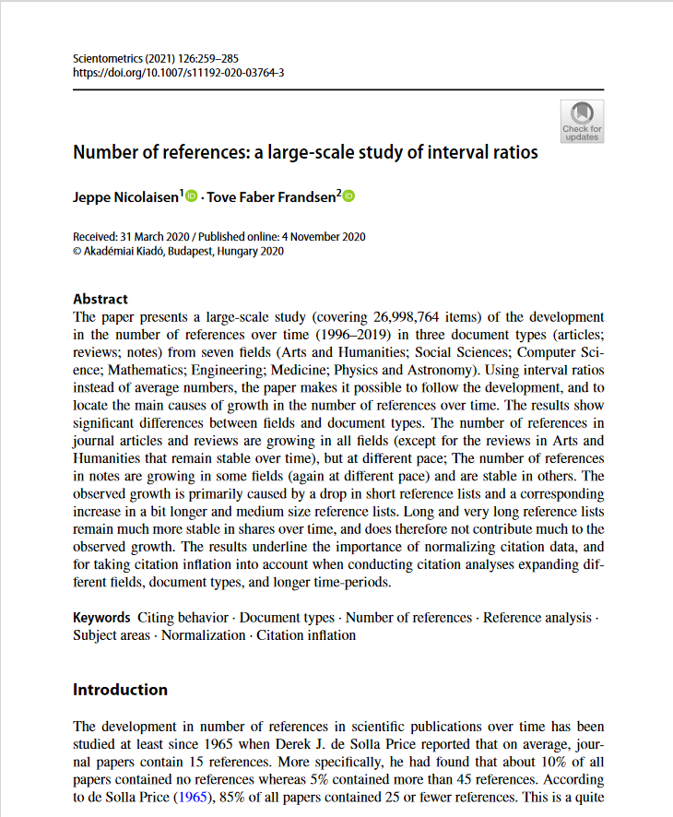
Version of Record

Slide 15
Green breakdown
Green OA
Version of Record is closed
Journal is hybrid
Free
Postprint is stored in an official repository (like CURIS)

Slide 16
Gold and Hybrid: A question of business model, not document type
Gold
Fully funded by Article Processing Charges (APC)
Hybrid
Funded by Article Processing Charges (APC) AND subscription fees
The entire journal is OA
Version of Record is OA
Version of Record is OA
The journal is BOTH paywalled and OA, depending on the article

Slide 17
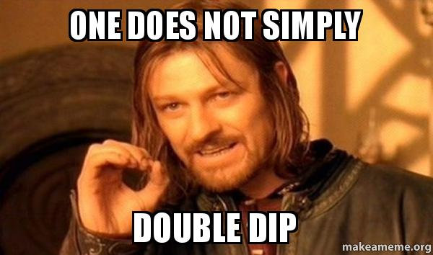
Hybrid: the worst of ‘both’ worlds

Slide 18
Diamond: the new kid on the block
Diamond
Version of Record is OA
Entire Journal is OA
Free to publish in

Slide 19
2.2 The OA Toolbox
HOW TO OA

Slide 20
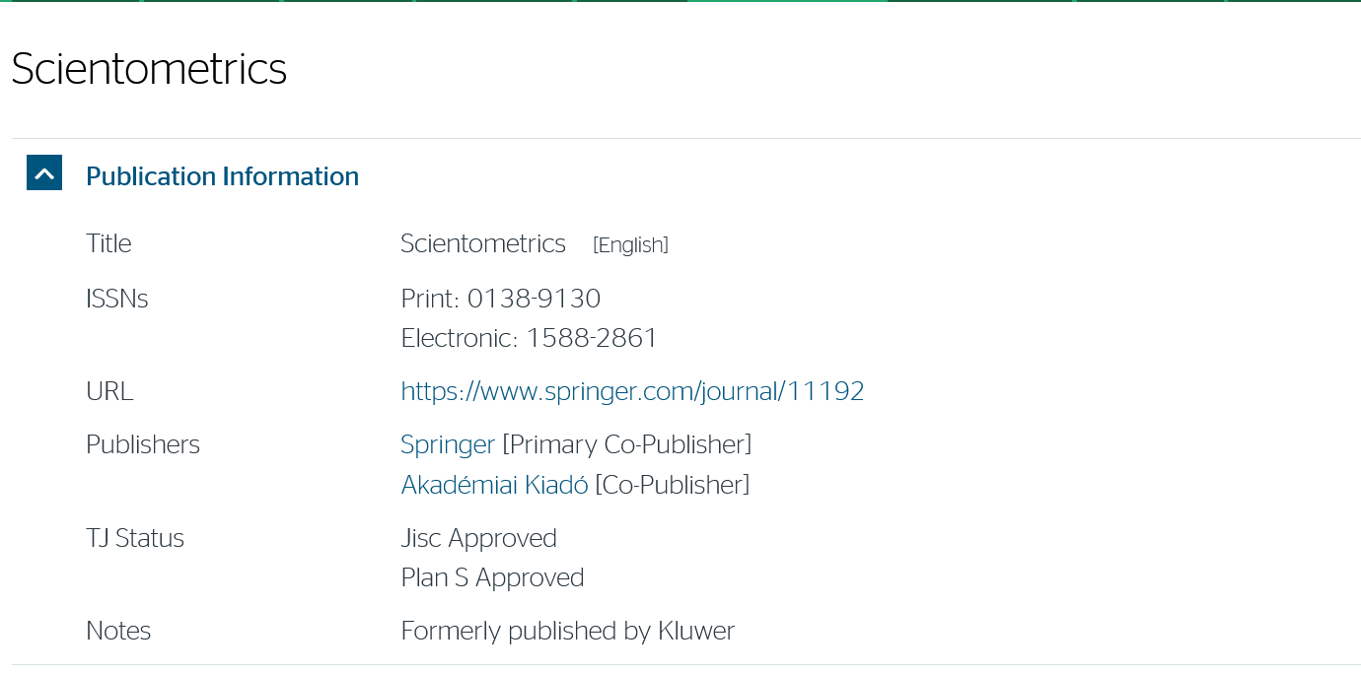
Sherpa Romeo – look up the OA policy of a journal
Source: https://v2.sherpa.ac.uk/romeo/
Notes:
For that purpose, we recommend that you use the website called Sherpa Romeo. Sherpa Romeo lists the journals’ open access policies. As an example, we will look at the journal of Clinical Psychology.

Slide 21
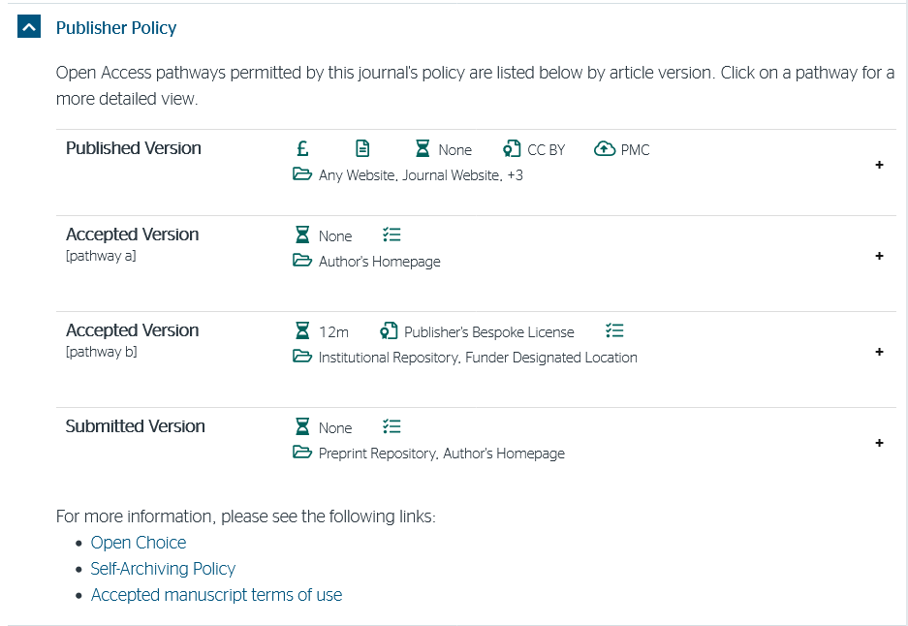
Symbols used in Sherpa Romeo
Notes:
Sherpa Romeo is using symbols to describe the options to publish OA. Let us look at the 3 most important symbols. When it comes to the published version of the article, the first symbol is the money symbol, indicating that you have to pay an APC to make the published version OA. Secondly the hourglass, which shows if there is any embargo period. Here it is stated none, meaning that if you pay an APC, the article is open access as soon as it has been published.
When it comes to the accepted version or the postprint, there is no money symbol and no embargo, meaning that you can make the postprint OA right away by uploading it to an Institutional Repository, meaning CURIS.
If the journal of Clinical Psychology is your first choice, Sherpa Romeo states in this way that you meet the requirements of the funders by uploading the postprint to CURIS – free of charge.

Slide 22
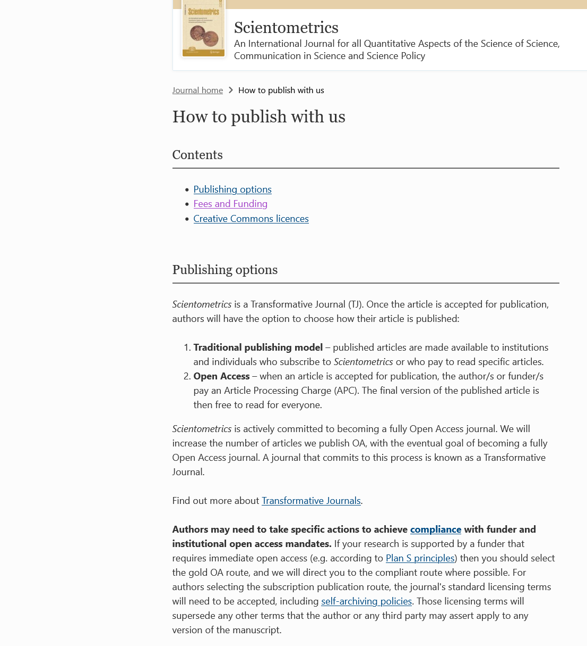
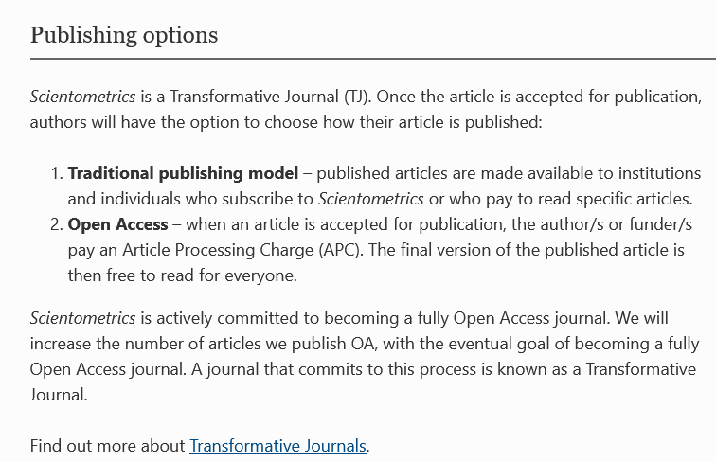
Find the journal’s open access policy
Notes:
We recommend that you doublecheck the information at Sherpa Romeo with the information at the webpage of the journal. In this case the information on the journal’ webpage corresponds with the information in Sherpa Romeo.

Slide 23
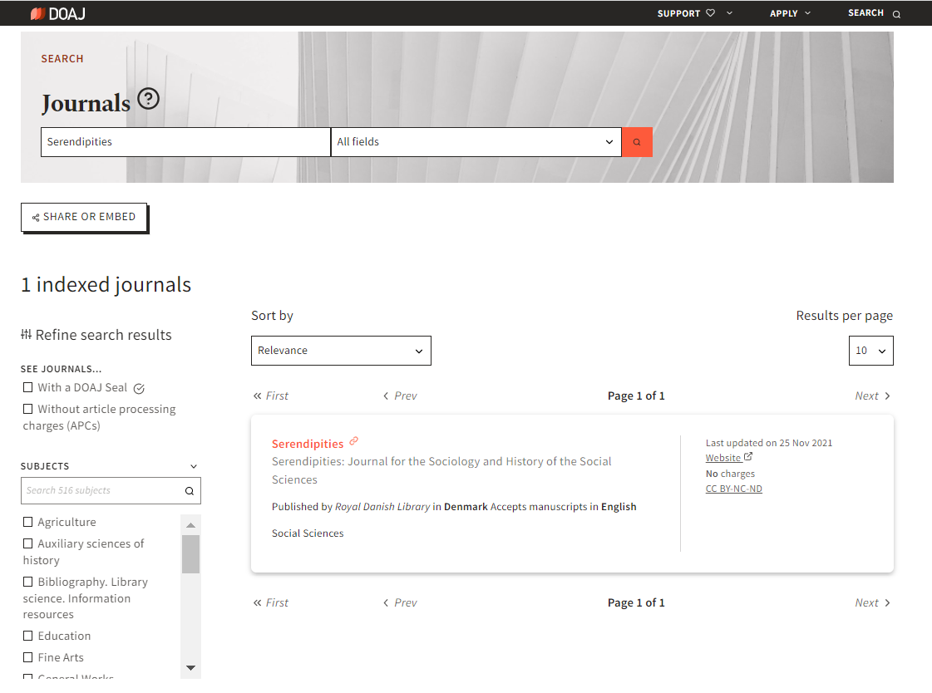
Directory of Open Access Journals (DOAJ)

Slide 24
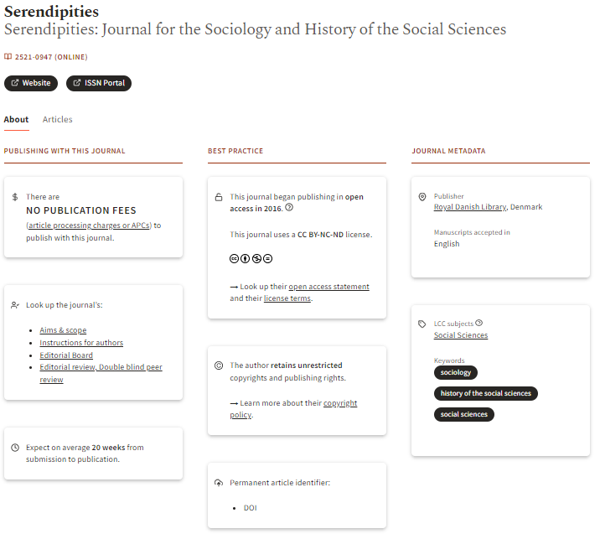
Directory of Open Access Journals (DOAJ)

Slide 25


2.3 Open Access in Research Policy

Slide 26
Open Access – strategies and measuring
National Open Access strategy: (Ministry of Higher Education and Science)
”…primarily focused on Green Open Access, while noting that Golden Open Access is widespread.”
Goal: 100% Open Access for scientific articles by 2025
Measured yearly through the Open Access Indicator (https://www.oaindikator.dk/en/)
University of Copenhagen:
”…the University will as widely as possible implement green Open Access.”
Publications to be uploaded to CURIS, the University’s institutional repository

Slide 27
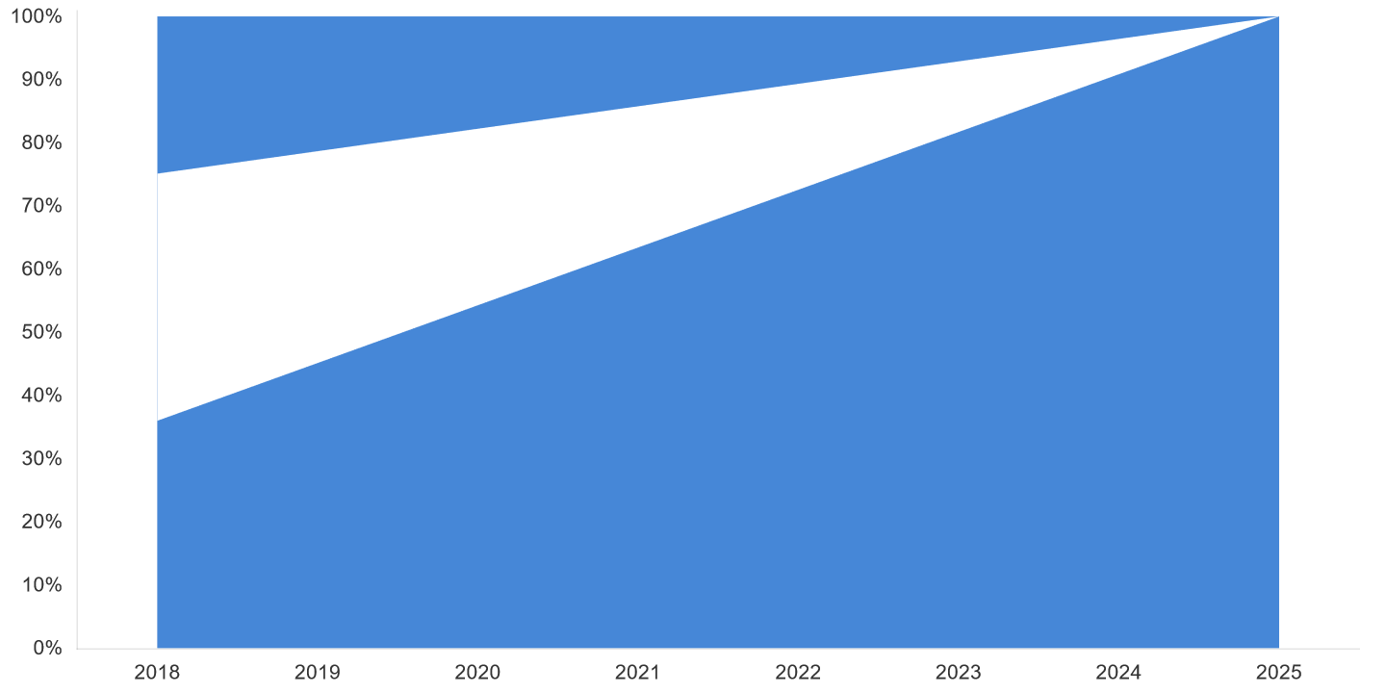
OA Indicator
BLOCKED
UNTAPPED
REALIZED OA
Source: OA Indicator https://oaindikator.dk/da/overview/

Slide 28
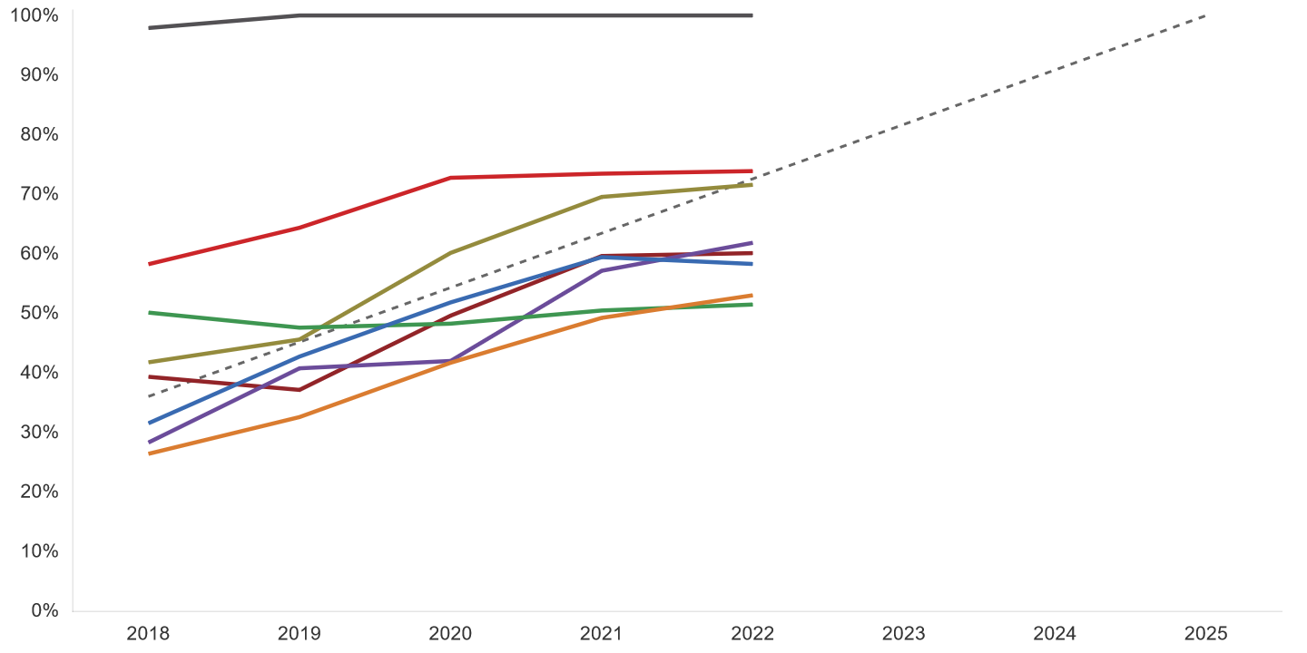
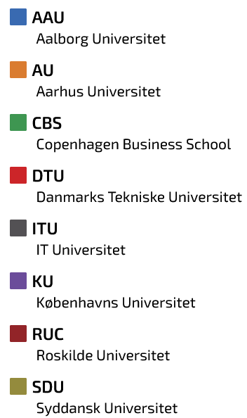
How are the Danish universities doing?

Slide 29
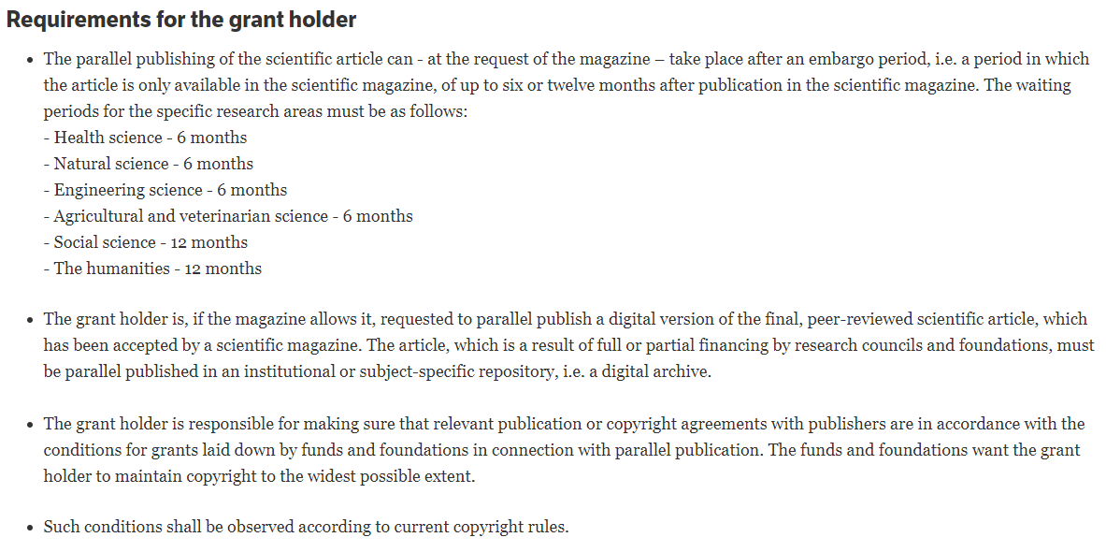
OA is now required from DK public grant holders
Independent Research Fund Denmark: https://dff.dk/en/about-us/goals-and-policies/open-access-policy

Slide 30
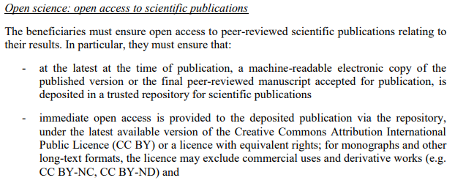
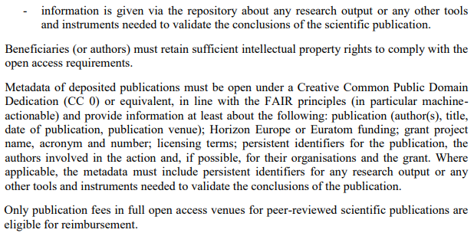
Horizon 2020 and Horizon Europe
Horizon Europe: General Model Grant Agreement (pages 110-111) is available here: https://ec.europa.eu/info/funding-tenders/opportunities/docs/2021-2027/common/agr-contr/general-mga_horizon-euratom_en.pdf

Slide 31

2.4 Article Processing Charges and the Libraries Agreements

Slide 32
APCs are really expensive
Usually cost several thousand Euros
The most expensive I have seen was 9500
Are we just stuck with these costs if we get funding!?

Slide 33

The Royal Library Consortium’s Deals with Elsevier and Wiley
APCs in all *hybrid* journals are waived for Royal Consortium-affiliated researchers
Check out the Research Portal on KUNet for more information and the full list of journals https://kunet.ku.dk/work-areas/research/publishing/open_access/Pages/default.aspx

Slide 34

3.0 A note on copyright

Slide 35
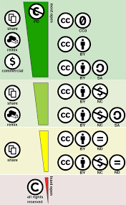
Open Licenses are not all the same
Source: Wikimedia https://commons.wikimedia.org/wiki/File:Creative_commons_license_spectrum.svg

Slide 36
4.0 Review
OA Types; Green, Gold, Hybrid and Diamond
Use Sherpa and DOAJ to plan an OA publishing strategy
OA is mandatory if connected to public grants
APCs waived on Hybrid journals from Elsevier and Wiley (yes!)
There are different ways to license your articles

Slide 37

4.1 Questions, Thoughts, Meditations, Reveries?
Source: Charlie Chaplin, The Great Dictator. 1940.

